Slide 1
Things to consider in choosing mutual fund
1.It shd be always in top 25
2. Track record always may not be best indicator, fund manager plays an important role, new fund manager might not perform well
3.If fund manager manages all schemes effectively then he is best
4. AUM (assets under management)earlier and compare with present AUM shd be less
Large cap, multi aum < 5000cr
Mid cap,small aum < 2000 cr
5. risk vs return
Return with less risk is prefer thank high risk
Large cap with 20% return over 10 years is better than mid cap with 21% over same period

Slide 2
Investing tips
We can opt SIP with 1000 / month
Check company prospects
check whether mf is for long term or short term based, how it is designed
What is risk factor and track record of mf
What are the return over last years
Track record of fund manager
What are the fees and taxes

Slide 3
NAV
We buy mfs in terms of units and each unit have a set price decided by fund manager which we call NAV
NAV net asset value it is the value of each mf
NAV = (assets – liabilities) /shares out standing
We will new nav on every day at the closing of the market

Slide 4
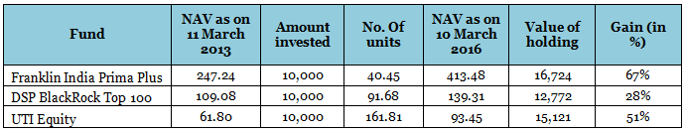
NAV - NET ASSET VALUE
There is no connection with returns and NAV VALUE.
Users tend to opt for low NAV MFS as they will get more num of units but performance of mf will vary based on scheme they opt and risk they take.
Nav is the price of each unit, if we have 500 units and nav is 10 then values of 500 units is 5000rs

Slide 5
You can invest lump sum amount or using sip
SIP is for new customers those who want to invest on monthly basis
AMC = asset management company
Every mf have bench mark which is part of sensex or nifty
We have to check our mf performance using this benchmark

Slide 6
Assets under management
Assets under management (AUM) is the total market value of assets that an investment company or financial institution manages on behalf of investors.
An expense ratio is the percent of your assets a fund company takes back each year in exchange for its services.
Mf short selling is not allowed in India

Slide 7
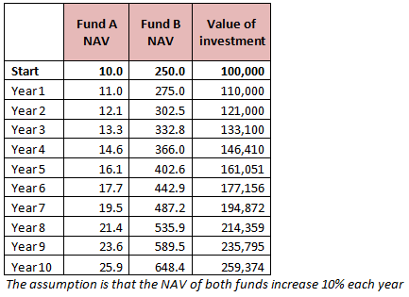
compounding
compounding is a long-term investment strategy. For example, when you own a mutual fund, compounding allows you to earn interest on your principal.
Higher the amnt of investment higher the compounding effect
Longer the period of investment will yield better results

Slide 8
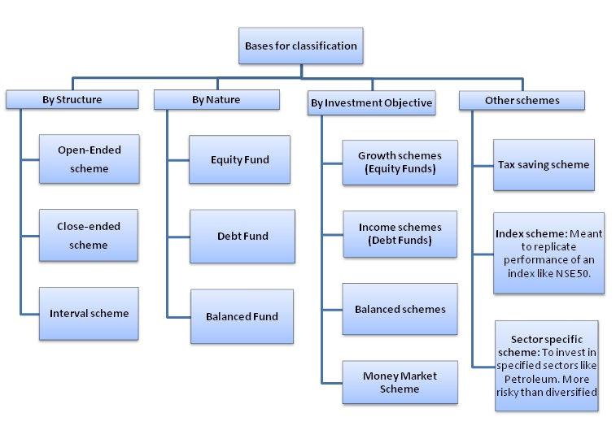

Slide 9
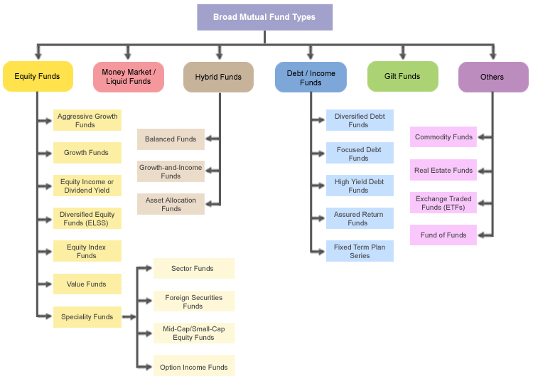

Slide 10
Risk types
Risk return trade off
Market risk
Credit risk
Inflation risk
Interest rate risk
Political / govt policy risk
Liquidity risk

Slide 11
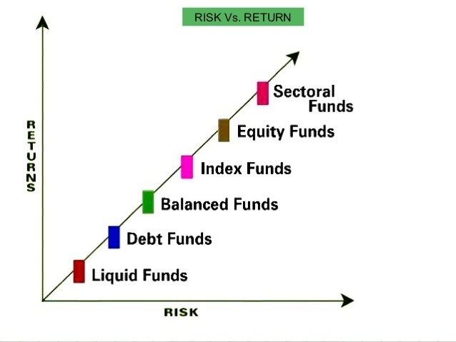

Slide 12
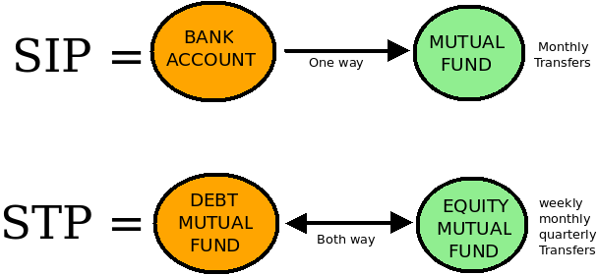
STP is useful when we want to change mf from equity type to debt mf.
This helps in diversification of the portfolio and helps to reduce risk when market is not in favors

Slide 13
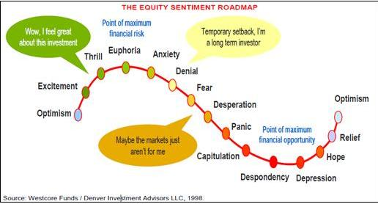
Psychology of an investor

Slide 14
diversification
don't invest in mf which are not performing good
Investing in all sectors irrespective of market trend is bad practice
Investing in mf which are low unit value is a bad practice
Following the market trend and out performing sector mf will be best bet.
Balancing the portfolio according to market status is diversification
It is a myth that you shd have all kinds of mfs such that if you get loss in one you can be saved by other kind of mf

Slide 15
Large cap funds
A large-cap fund puts most of its portfolio in large-cap stocks. They aim to play only on the large-cap space and usually have the Nifty 50, Sensex, Nifty 100, or BSE 100 as benchmarks.
Examples are Franklin India Bluechip, ICICI Prudential Focused Bluechip, DSP BlackRock Top 100.
the proportion of large-caps stocks in large-cap funds is around 80 per cent of the portfolio.
Large-cap funds form your portfolio’s foundation. Since large-cap stocks are less volatile and have superior market liquidity, their returns don’t see very wild swings unless the broad market itself crashes or booms. These funds provide stability to your portfolio and are therefore a must-have.
Some large-cap funds include a measure of mid-cap stocks (usually around 15-20 per cent of the portfolio) in order to boost overall returns.
Examples of such funds are SBI Bluechip, Axis Equity, BNP Paribas Equity, Kotak Select Focus, and so on.
Because of this leeway to include mid-caps, such funds are slightly riskier.

Slide 16
Mid cap and small cap funds
A mid-cap or small-cap fund invests primarily in smaller companies.
Mid-cap stocks as those with market caps of between Rs 2,500 and Rs 15,000 crore.
Stocks below Rs 2,500 crore are small-caps. The degree of risk depends on the level of market cap of the portfolio.
The range of risk levels in mid-cap and mid-and-small cap funds is therefore wide.
Examples are DSP Blackrock Micro Cap, Reliance Small Cap, or Franklin India Smaller Companies pick funds from the lower end of the range – or small companies – thus becoming the riskiest. These are small-cap funds, or mid-and-small-cap funds.

Slide 17
Given the high risk-high return nature of these funds, they help boost portfolio returns.
No matter what your risk appetite is, it is better to cap allocation to these funds at around 40 per cent of your portfolio.
Generally, shorter-term portfolios of around 3-4 years should not have a pure mid-cap fund unless you are a very high-risk investor.

Slide 18
Diversified(multicap funds)
These funds in both large and mid cap funds.
Depending on market fluctuations these switch between large and mid cap, hence there is chance of little risk
These are better if you want return kick starter if you don’t want to take high risk
These are best for portfolios of shorter time horizon
Examples are like Mirae Asset India Opportunities and Franklin India Prima Plus

Slide 19
Sector funds
These are the highest risky funds of all
It is because their performance depends on whether that sector is doing well or not.
It should not be in long time portfolio and is wisely selected when that particular sector performing well in that time period.
ICICI Pru FMCG Fund – Direct (G), Reliance Banking Fund, UTI Banking and Financial Services
There are many sectors like pharma, it, banking, fmcg, real-estate

Slide 20
Balanced funds
A balanced fund is another option for intermediate-term investors. Balanced funds, which are often called hybrid funds, own both stocks and bonds. They earn the "balanced" moniker by keeping the balance between the two asset classes pretty steady, usually placing about 60% of their assets in stocks and 40% in bonds.
The fund scheme aims periodic returns and long-term capital appreciation from a balanced portfolio of debt and equity.
Examples are like HDFC balanced fund, l&t india prudence fund, icici prudential balanced fund

Slide 21
Open ended and close ended
The difference between the two depends on the flexibility of sale and purchase of fund units.
The number of outstanding units goes up or down every time the fund house sells or repurchases the existing units.
This is the reason that the unit capital of an open-ended mutual fund keeps varying.
The fund expands in size when the fund house sells more units than it repurchases as more money is flowing in. On the other hand, the fund’s size reduces when the fund house repurchases more units than it sells.
Examples are Motilal Oswal Multicap 35 FundSBI Bluechip FundSBI Magnum MultiCap FundMirae Asset Emerging Bluechip FundL&T Tax Advantage FundDSP BlackRock Equity Opportunities FundAditya Birla Sun Life Tax Relief 96ICICI Prudential Bluechip FundICICI Prudential Equity & Debt FundL&T India Value Fund

Slide 22
Close ended funds
The unit capital of closed-ended funds is fixed and they sell a specific number of units.
Unlike in open-ended funds, investors cannot buy the units of a closed-ended fund after its NFO period is over.
This means that new investors cannot enter, nor can existing investors exit till the term of the scheme ends.
However, to provide a platform for investors to exit before the term, the fund houses list their closed-ended schemes on a stock exchange.
Apart from listing on an exchange, these funds sometimes offer to buy back the units, thus offering another avenue for liquidity.
Examples are reliance capital builder series2, UTI focused equity series1 and 2,icici pru growth series1
open-ended funds have outperformed the closed-ended funds comprehensively.

Slide 23
Debt funds
There are broadly 7 types of debt funds
1. gilt funds
2. income funds
3. short term debt funds
4. credit opportunities funds
5. fixed maturity plan funds
6. liquid funds
7. monthly income funds

Slide 24
1. Gilt funds
Gilt funds invest in Government securities with varying maturities.
Average maturities of government bonds in the portfolio of long term gilt funds are in the range of 15 to 30 years.
The returns of these funds are highly sensitive to interest rates movements.
The NAVs of gilt funds can be extremely volatile. The primary objective of Gilt Funds is capital appreciation.
Investors with moderate to high risk tolerance level, looking for capital appreciation, can invest in Gilt Funds.
Examples are SBI Magnum Constant Maturity Fund Growth, ICICI Prudential Long Term Gilt Fund Growth, Reliance Gilt Securities Fund Growth

Slide 25
2.Income funds
Monthly Income Plans (MIPs) are best for individuals who are looking for steady income.
Monthly Income Plans from mutual funds are nothing but debt funds as they invest most of the corpus in debt instruments.
Aggressive MIP funds invest 16%-30% in equity securities and the remaining in debt securities. This can be a bit risky for retirees and ultra-conservative investors as the investment portion is higher in aggressive MIPs. Examples areBirla Sun Life MIP II - Wealth 25 Plan, Franklin India Debt Hybrid Fund, ICICI Prudential Ultra Short Term Fund

Slide 26
3.Short term debt funds
Short term bond funds invest in Commercial Papers (CP), Certificate of Deposits (CD) and short maturity bonds.
The average maturities of the securities in the portfolio of short term bond funds are in the range of 2 – 3 years.
Short term debt funds are suitable for investors with low risk tolerance, looking for stable income.
Examples are like birla short term debt fund, escorts short term debt fund.

